Slide 1
DevOps for the Commodore 64

Slide 2
**** DevOps for the Commodore 64 ****
So what’s your excuse?
10 PRINT “Todd Whitehead”
20 GOTO 10


Slide 3
Agenda
Personal Intro: working at MS, clients, moving to cloud challenges
DevOps: What is it? What are the advantages? Why Not Do it?

Slide 4
What is DevOps
People
Process
Technology

Slide 5
Why should you care?
DevOps high performers

Slide 6
Challenges/Excuses

Slide 7


Slide 8
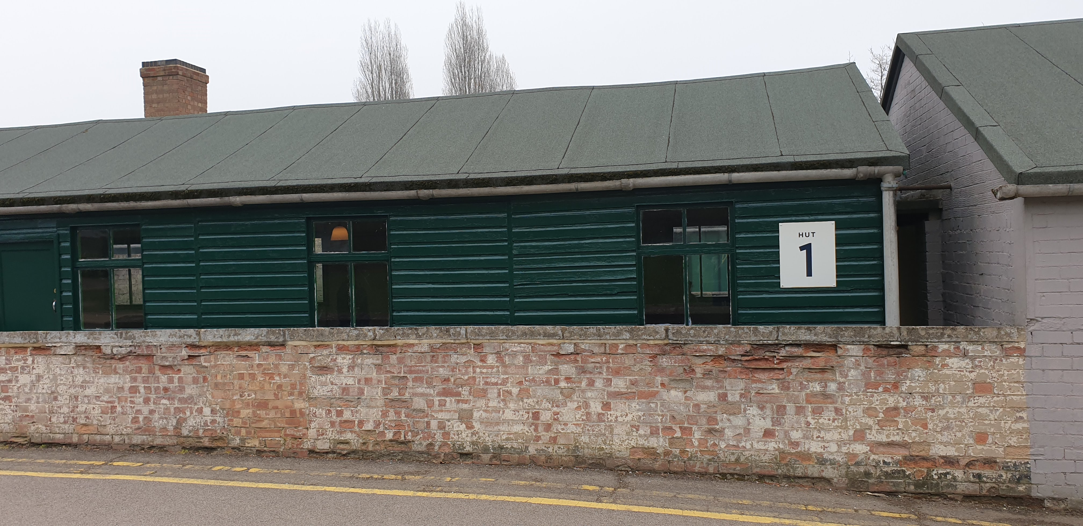

Slide 9
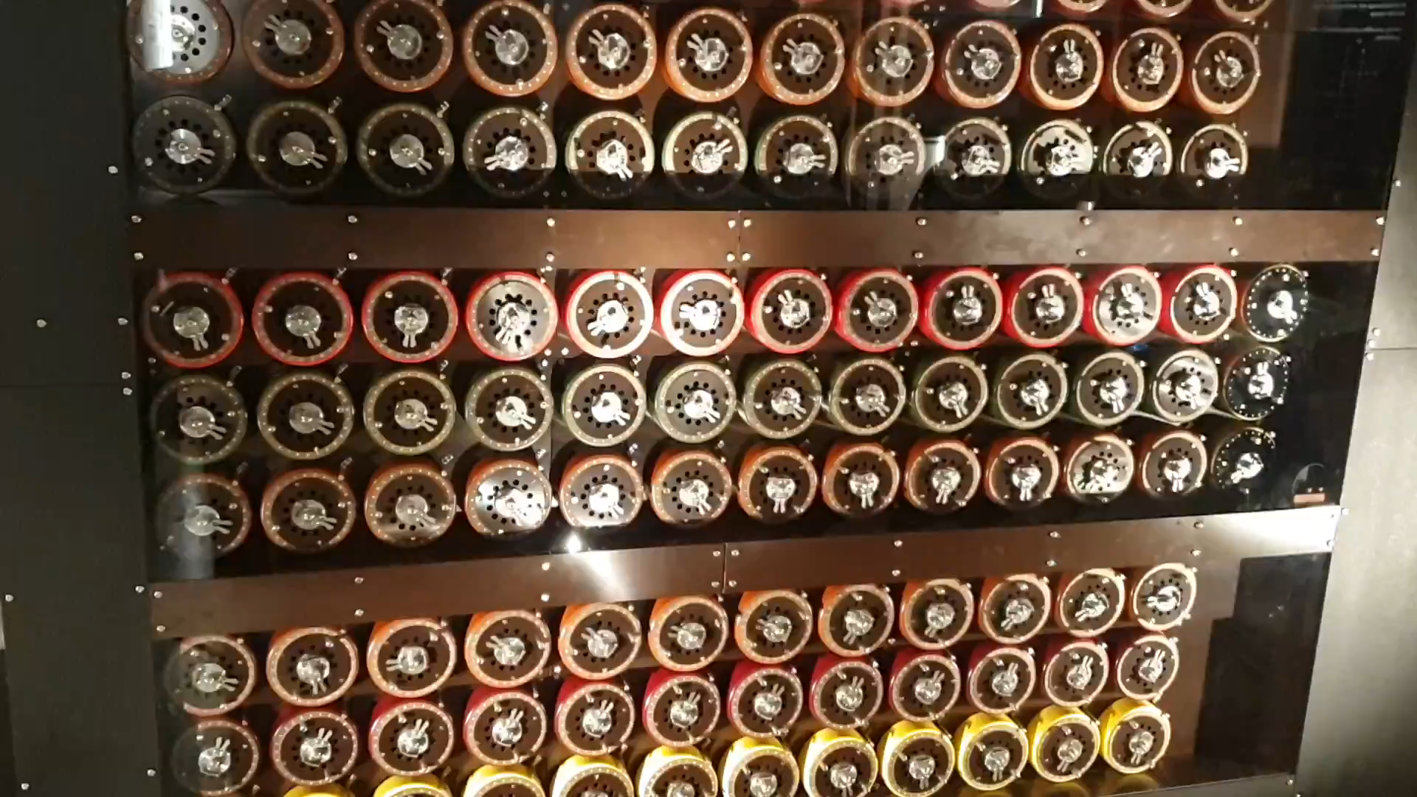

Slide 10
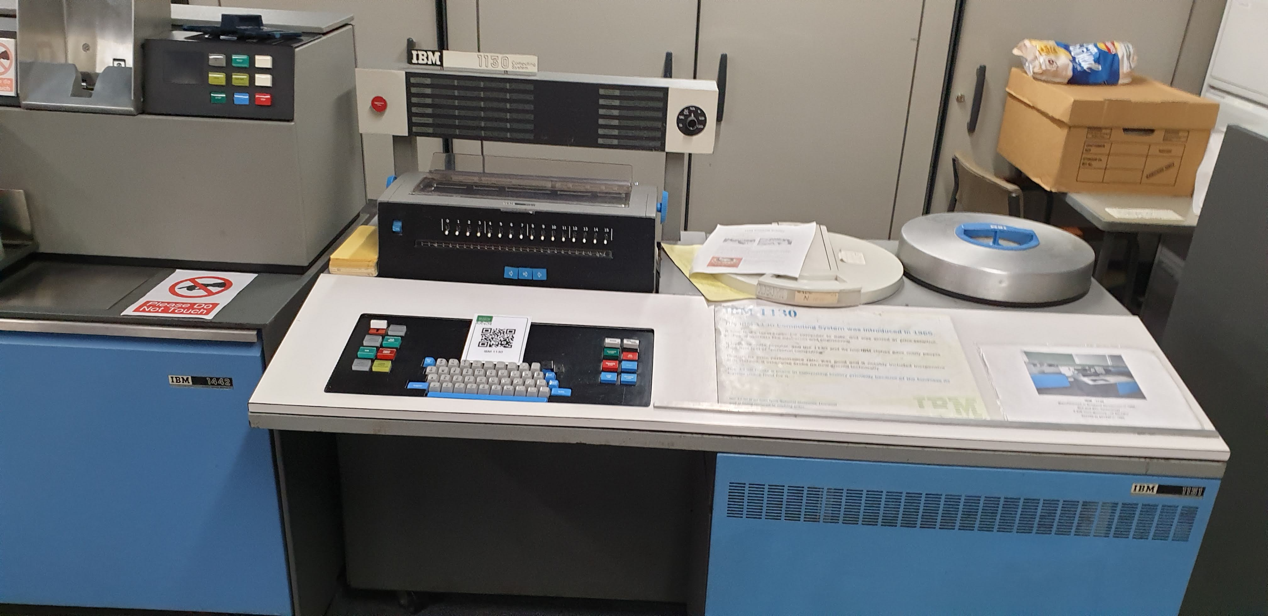

Slide 11
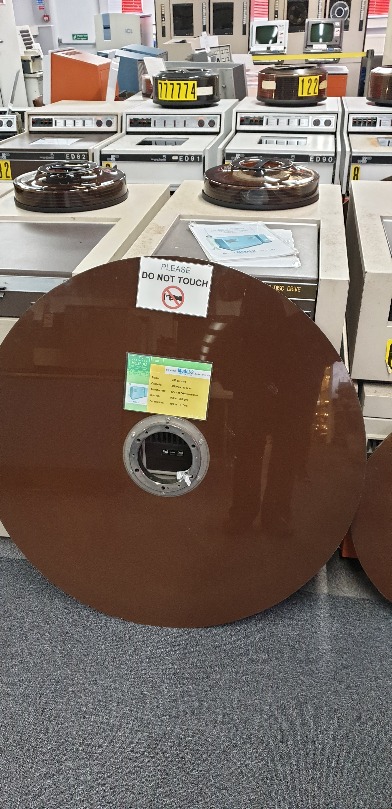
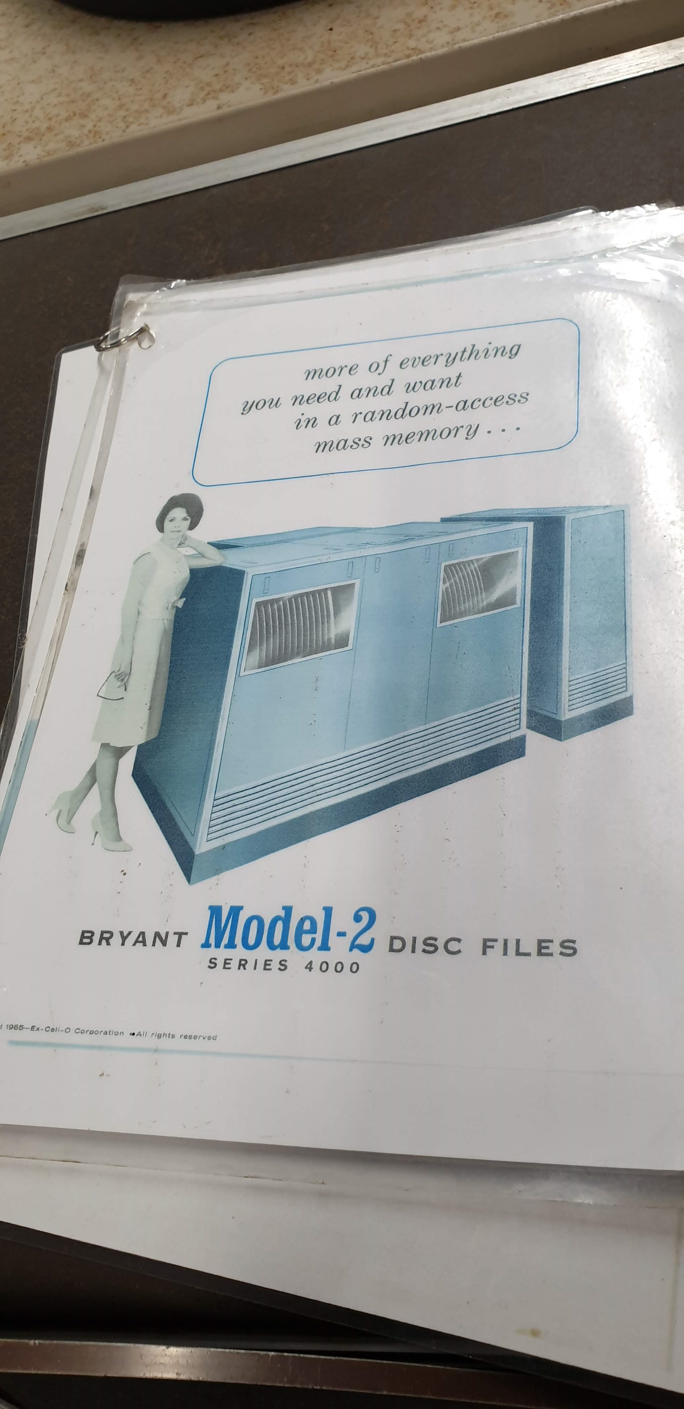

Slide 12
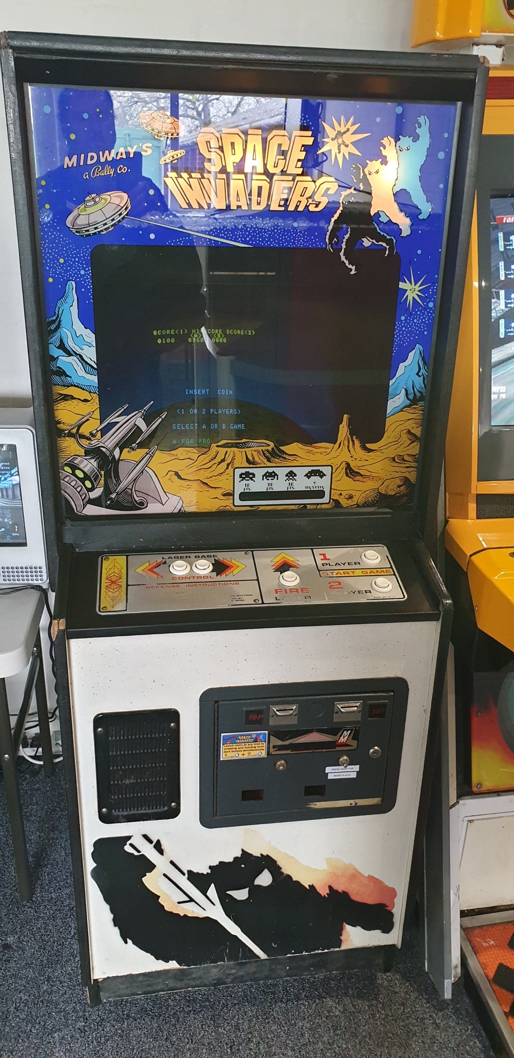
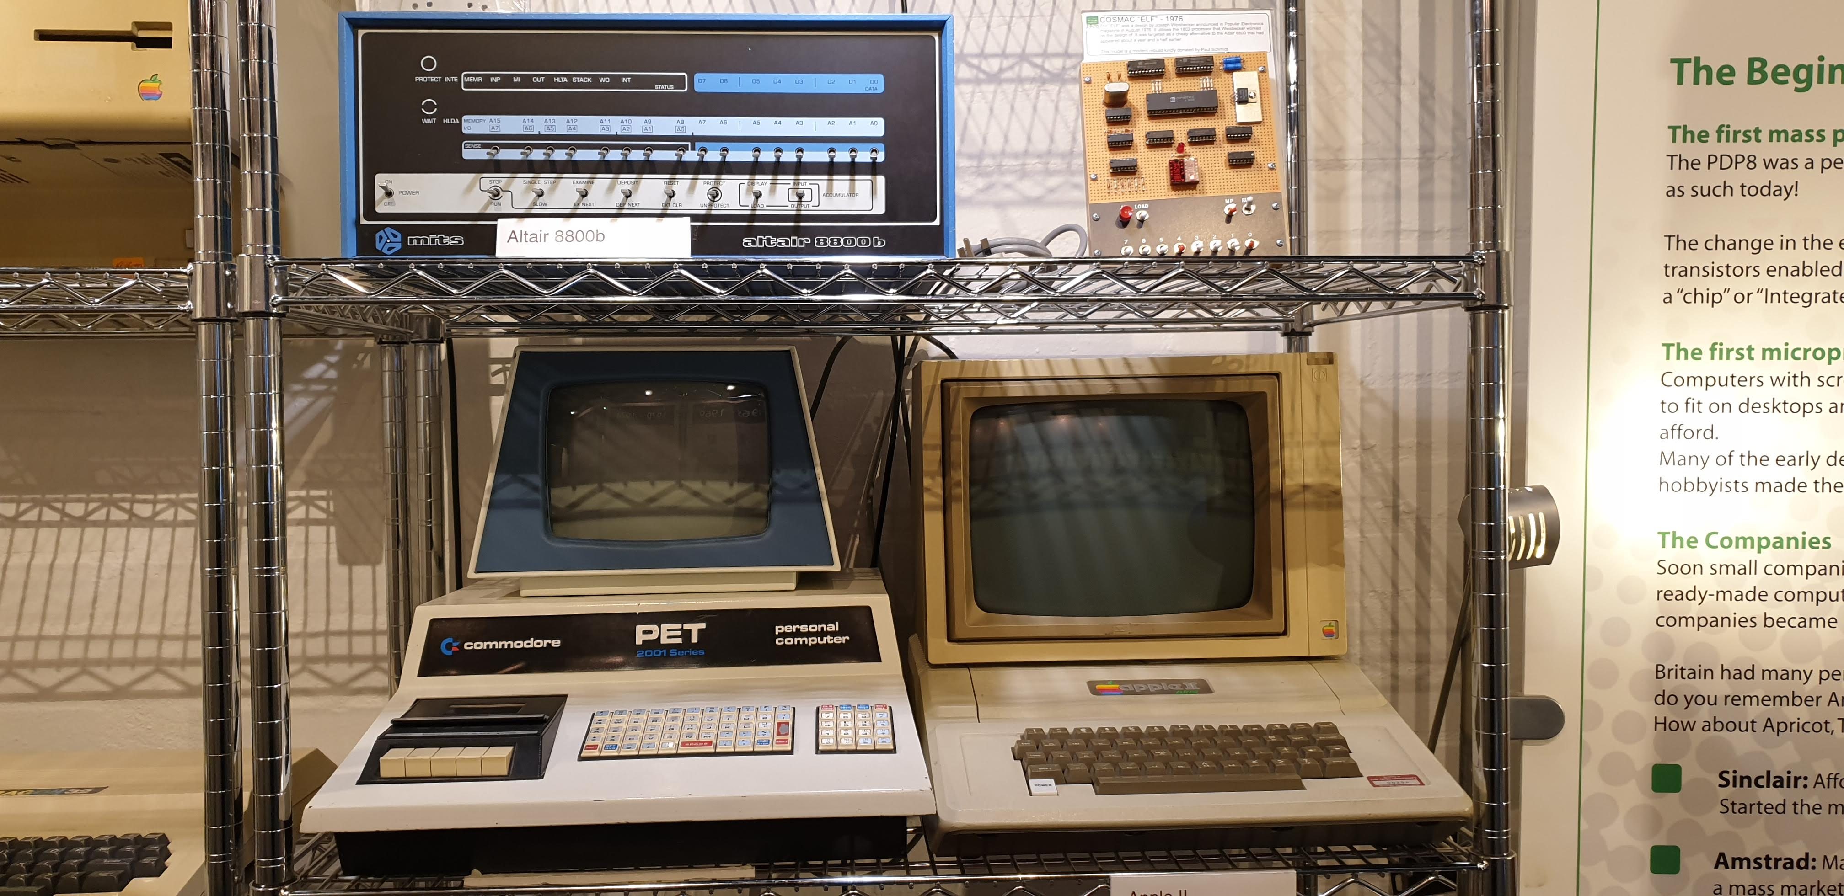
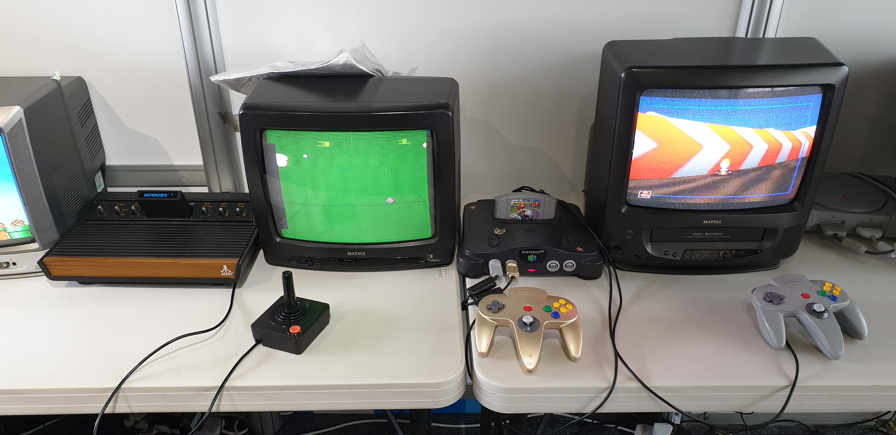

Slide 13
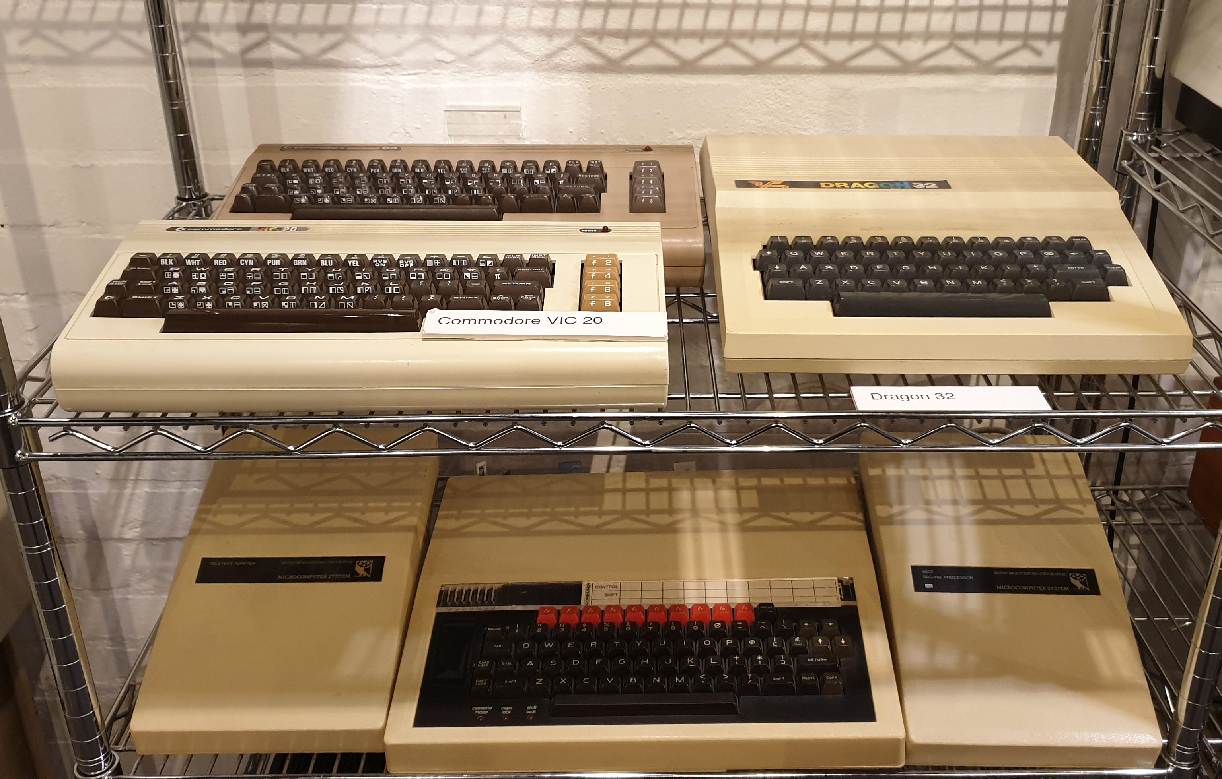

Slide 14
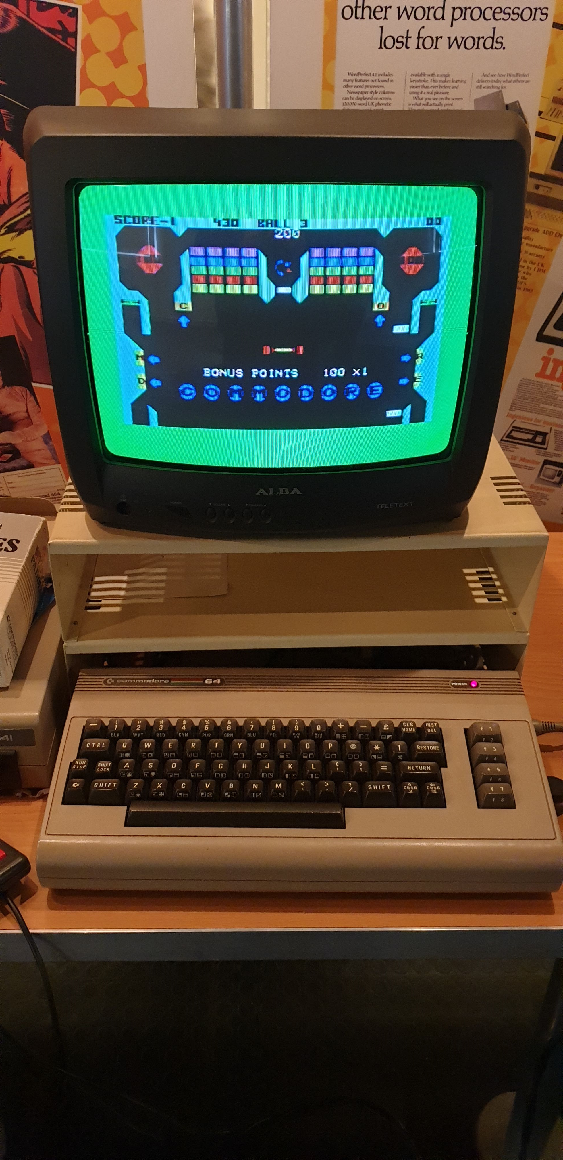

Slide 15
**** DevOps for the Commodore 64 ****
So what’s your excuse?
10 PRINT “CONNECTIVITY IS HARD”
20 PRINT “TOOLS NOT DESIGN FOR IT”
30 PPRIT “OUR PROCESS IS SPECIAL”


Slide 16
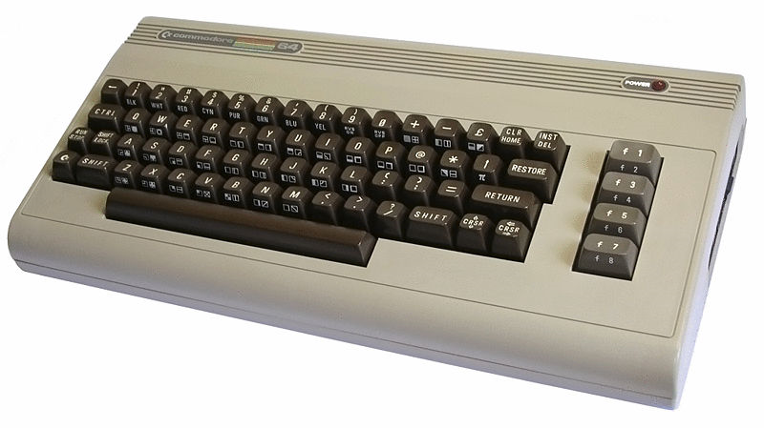
Notes:
The C64 enjoyed several advantages over its rivals:
It could use the whole 8-bit memory-map (64 kilobytes).
It provided advanced sound and graphics features (like sprites, HiRes, and multicolor).
Existing VIC-20 peripherals could be used (after a little remodeling).
Older Commodore BASIC programs (up to version 2.0) could be used.
It had other cartridges for programming languages such as Logo and Pascal.

Slide 17
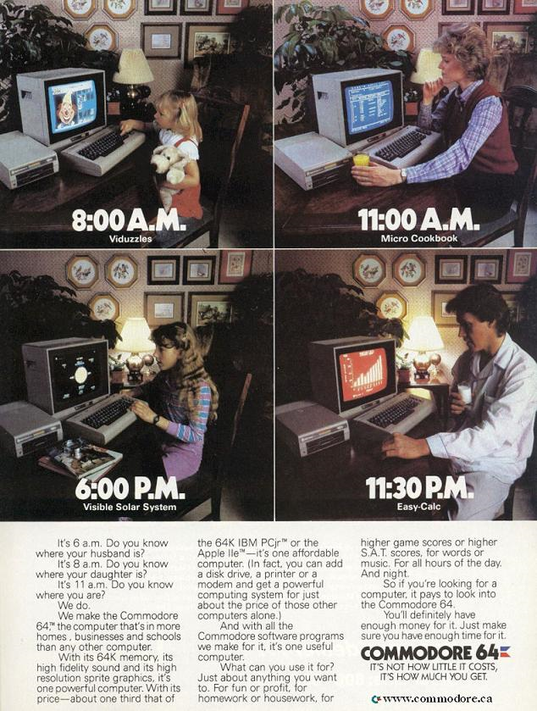
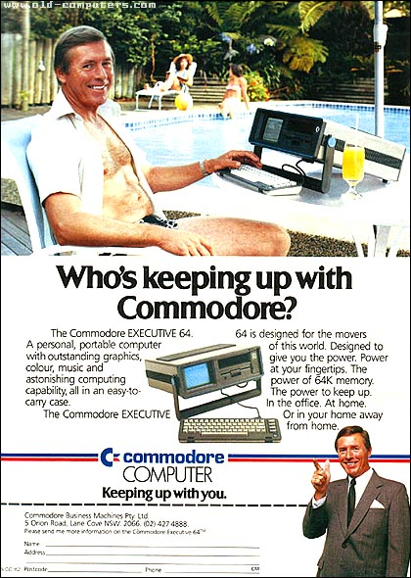

Slide 18
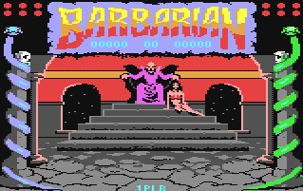

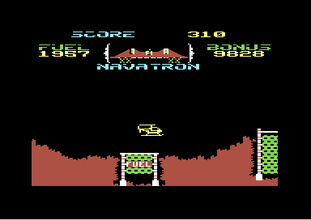
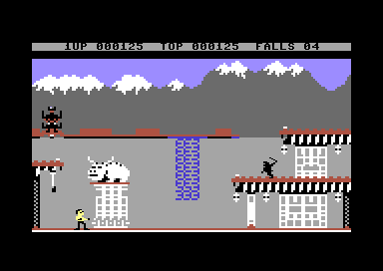
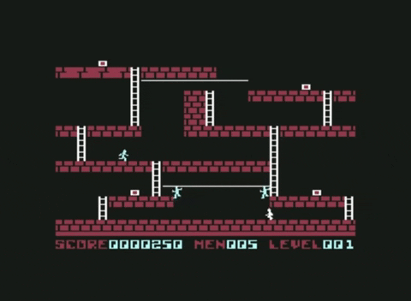
Notes:
The games were awesome

Slide 19
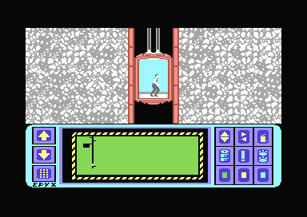
Notes:
Sound

Slide 20
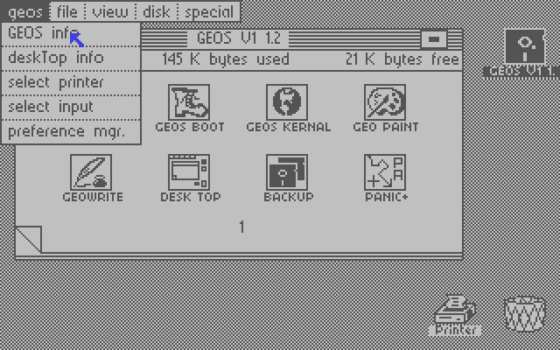
Notes:
http://toastytech.com/guis/c64g.html
GEOS, released in 1985, is a full blown operating system and graphical user interface for the Commodore 64 computer.

Slide 21
**** 6502 Processor ****
Commodore 64
Commodore VIC-20
Commodore PET
1541 Floppy Drive
Apple I
Apple II
Atari 8-bit family
Acorn Atom
BBC Micro
Ohio Scientific
Oric
Atari 2600
Nintendo Entertainment System
Atari Lynx
Tamagotchi

Slide 22
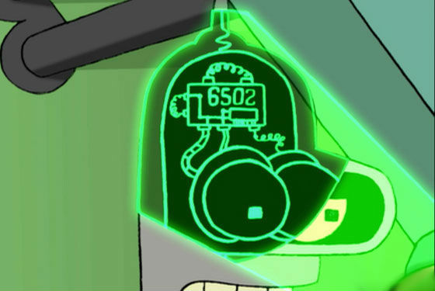

Slide 23
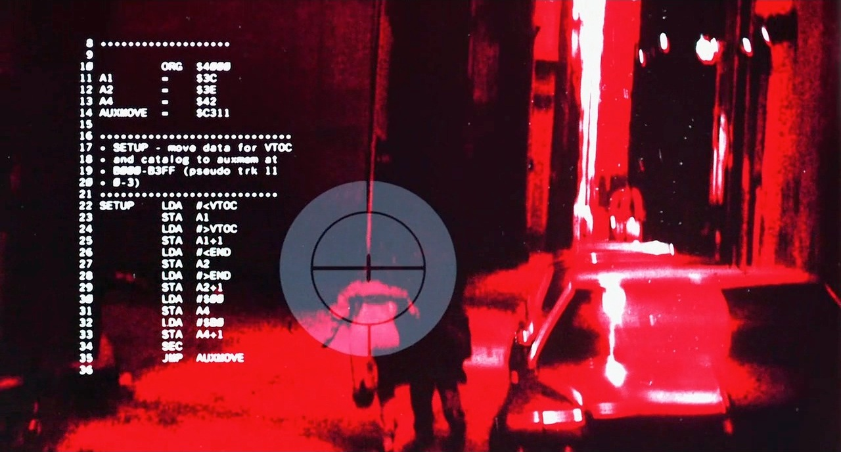

Notes:
https://www.pagetable.com/?p=64
In the first Terminator movie, the audience sees the world from the T-800’s view several times. It is well-known that in two instances, there is 6502 assembly code on the T-800’s HUD, and many sites have analyzed the contents: It’s Apple-II code taken from Nibble Magazine.
Checksum application Key Perfect on a file names “OVLY.OBJ”, which prints a 16 bit checksum for every 0x50 bytes:

Slide 24
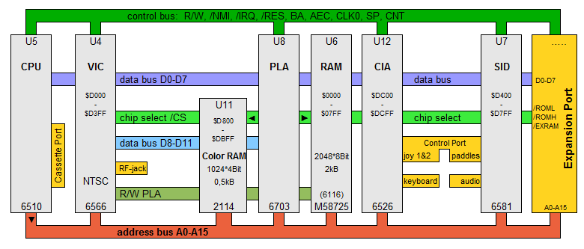

Slide 25
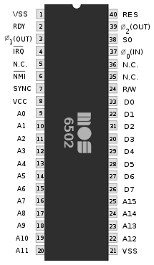
255
65,536

Slide 26
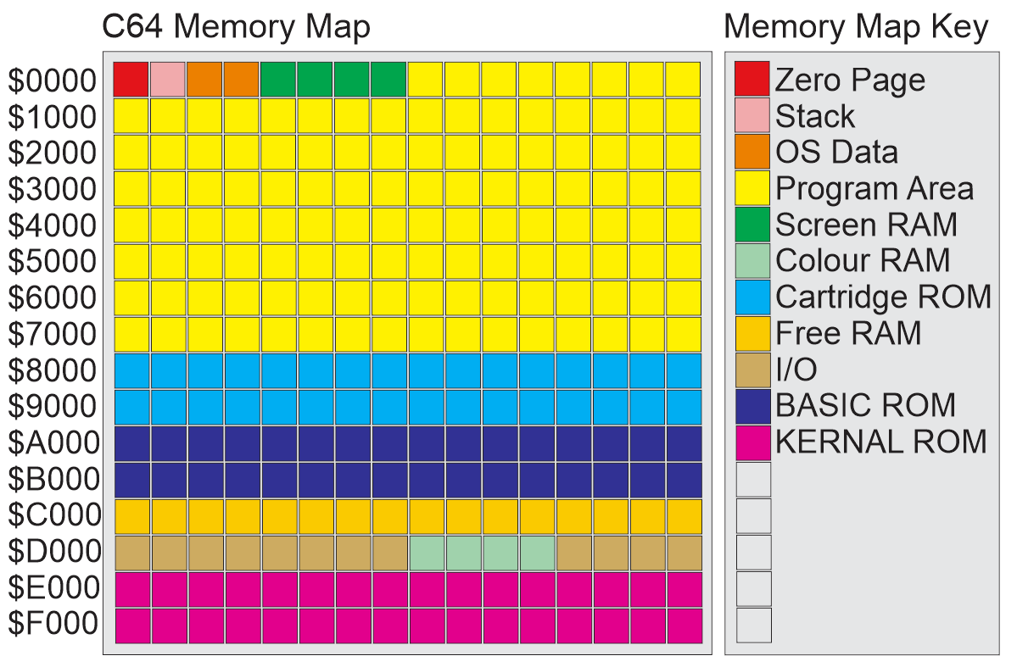

Slide 27
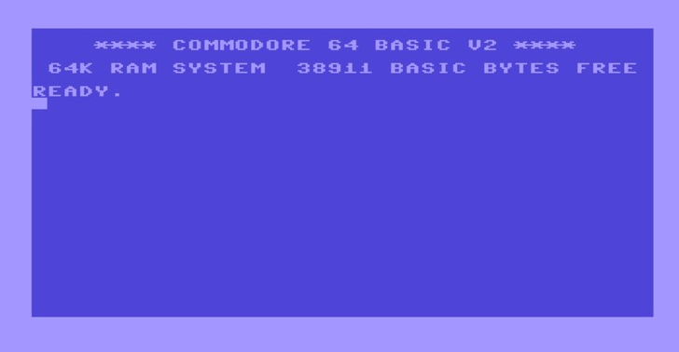

Slide 28
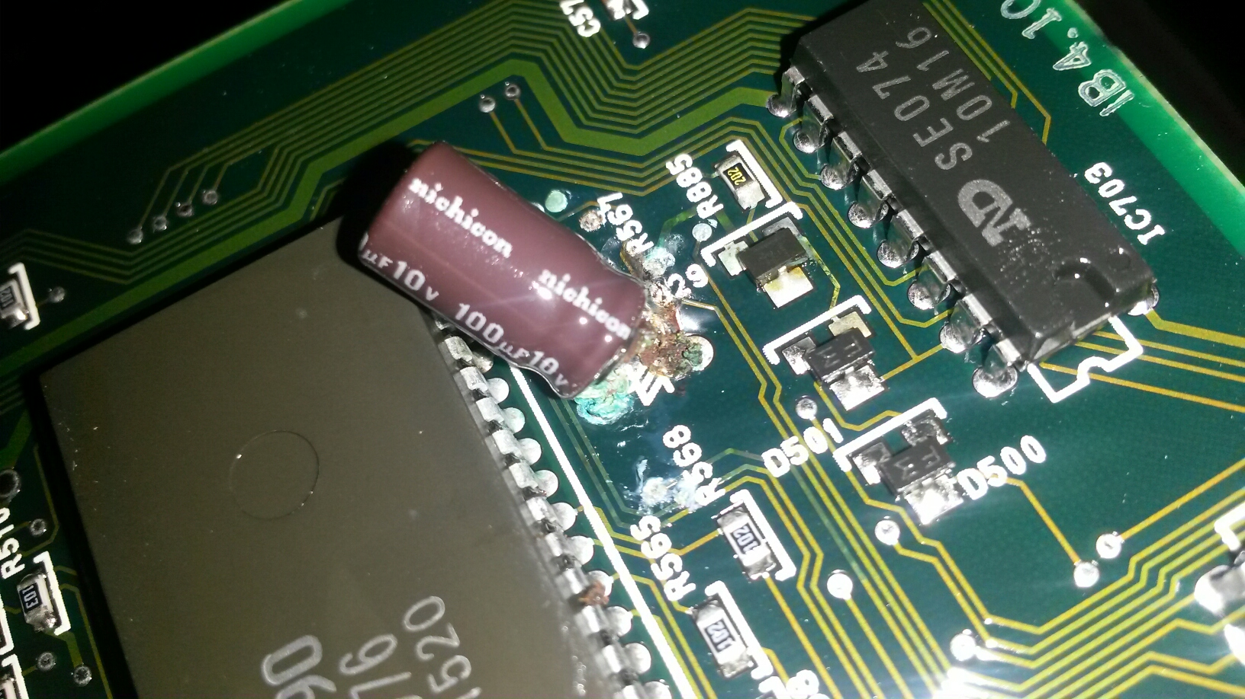

Slide 29
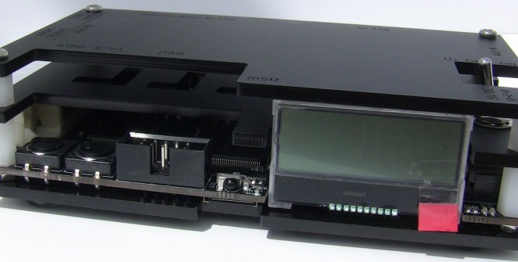
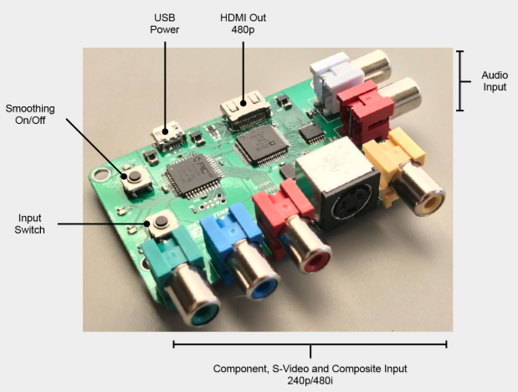
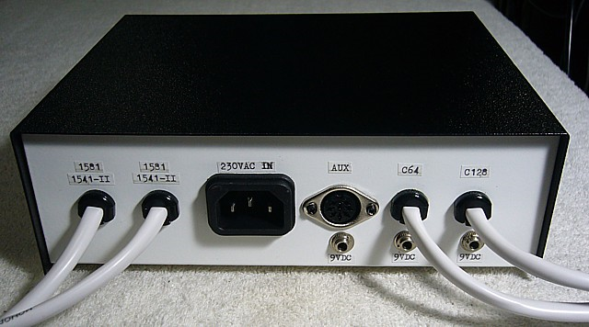
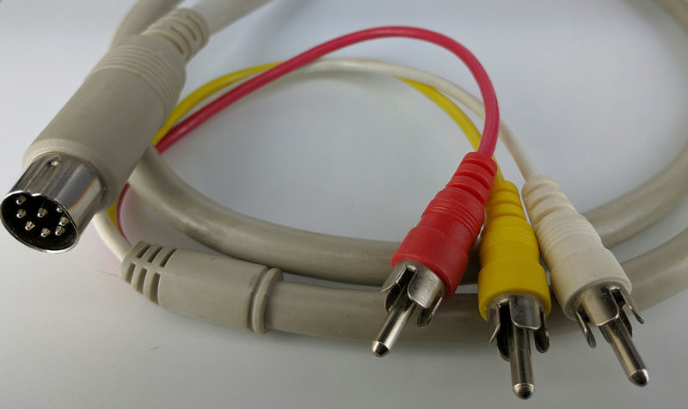
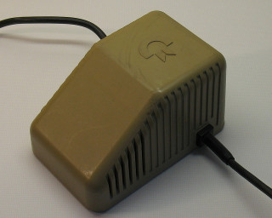

Slide 30
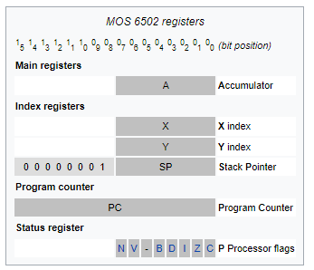
Notes:
A 6502 assembly language statement consists of a three-character instruction mnemonic, followed by any operands.

Slide 32
**** DevOps for the Commodore 64 ****
How Basic was basic?
LOAD
SAVE
OPEN
LOAD “$”,8
LIST

Slide 33
**** DevOps for the Commodore 64 ****
How Basic was basic?
LOAD
SAVE
OPEN
OPEN 15,8,15,”N0:DISK,I64″:CLOSE 15

Slide 35
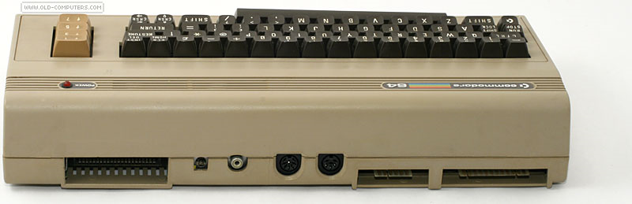
Notes:
Replace Photo
Expansion port (44-pins; i/o) to connect cartridges
TV-connector (HF-Modulator-Output; o) to connect a television (in the versions NTSC or PAL)
Audio-/Video (5-pins; o) to connect a monitor or a stereo
Serial Bus (IEEE-488, 6-pins, i/o) to connect a diskdrive 1541/70/71/81 or printer MPS-801/802/803, VIC-1515/1525/1526
Cassette Connector (Cassette port 12-pins; i/o) to connect a cassette recorder (Datasette) 1530 or CN2
Userport (RS-232 or Centroncis; 24-pins; i/o) to connect cartridges, reset button or modems.

Slide 36
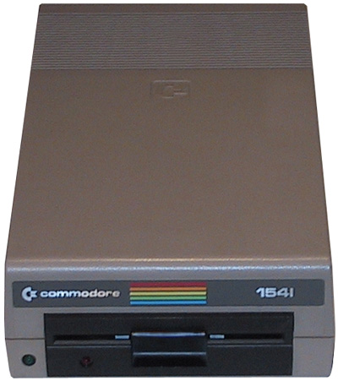
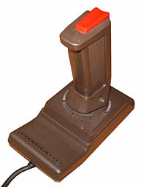
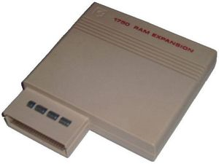
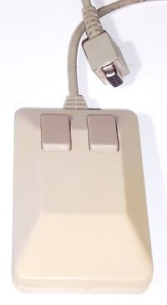
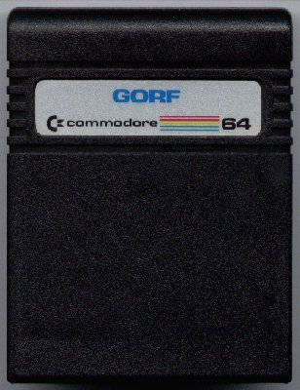
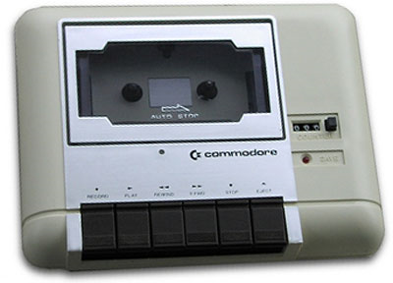

Slide 37
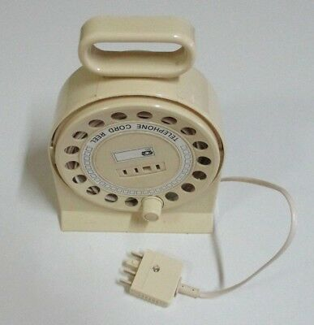

Slide 38
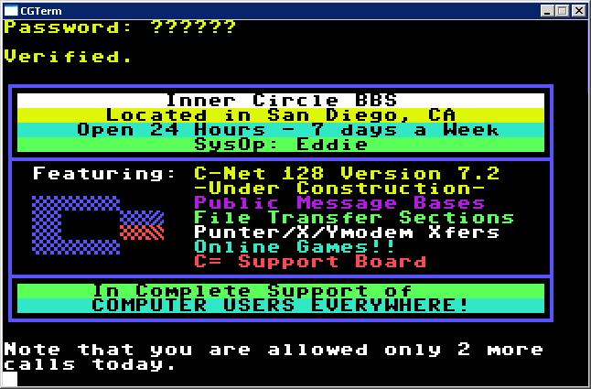

Slide 39
